Slide 1
Introduction

Slide 2
objectives
To understand the basic objectives and scope of computer graphics
To identify computer graphics applications
To understand the basic structures of 2D and 3D graphics systems
To understand evolution of graphics programming environments
To identify common graphics APIs
To understand the roles of Java language, Java 2D and Java 3D packages
To present a basic graphics skeleton with Java.
To identify computer graphics related fields

Slide 3
Computer graphics
Computer graphics provides methods to generate images using a computer.
An image can represent a realistic scene from the real world, but graphics like histograms or pie charts as well as the graphical user interface of a software tool are also considered as images.
Computer graphics applications cover:
Graphical user interfaces (GUIs)
Visualising high-dimensional data
Generation of realistic images and sequences of images
Designing, modelling and visualising objects
The combination of real data and images with techniques from computer graphics will probably gain more importance than it has today.

Slide 4
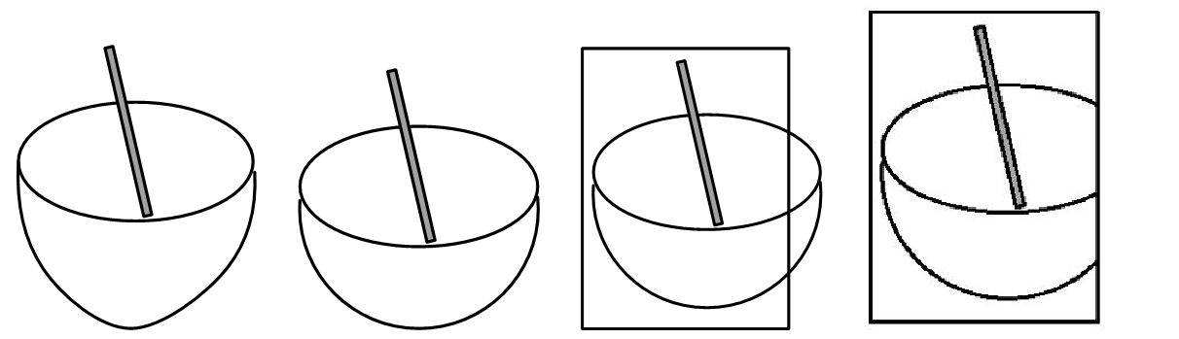
From real scene to an image
The objects in the scene have to be modelled with the techniques and methods provided by a computer graphics tool.
Approximation by assuming that the computer graphics tool is very restricted and the bowl in the real scene can only be approximated by a semi-sphere.
Projection from 2D to 3D
Clipping, The whole process of generating a pixel image from a three-dimensional virtual scene is called rendering.

Slide 5
Computer graphics main tasks
Main tasks of computer graphics: modeling a virtual world and rendering a scene
Modeling: Creating a virtual world.
Rendering: Generating a visual image of a scene.

Slide 6
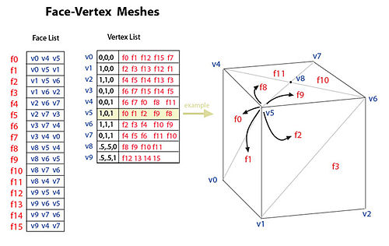
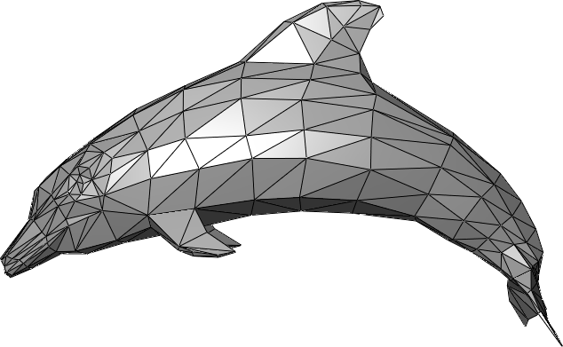
Computer graphics- modeling
A common modelling primitive is a polygon.
A polygon is a simple geometric shape that is defined with a list of vertices.
It is very powerful primitive.
Many shapes can be stored as a list of polygons in terms of vertex list.

Slide 7
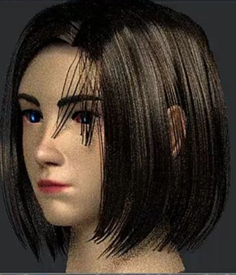
Computer graphics- modeling
Shapeless objects –curtains, hair, fire… are commonly modeled with splines rather than polygons.

Slide 8
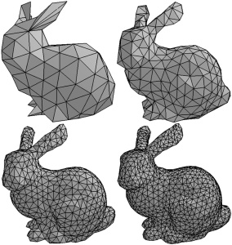
Modeling-level of detail
There are always several approximations for a shape depending on the application.
The process of reducing the complexity(number of polygons) of the scene in order to improve frame rate is called approximation.

Slide 9
Computer graphics –common vocabulary
Graphics objects to be modeled are in either a 2D or a 3D space.
This common space to host all the graphic objects is often called the world space
The graphics objects to be modeled in a world space are usually geometric entities such as lines and surfaces, but they also include other special objects such as lights, texts and images
The graphics objects may possess many characteristics and properties such as color, transparency and texture.
Modeler is responsible for the construction of virtual world models
Renderer perform the rendering of the scene
Object transformations are geometric transformations applied to the objects to achieve the proper placement of the objects in the virtual space

Slide 10
Computer graphics –common vocabulary
Object transformation is the mapping of the object spaces into world space that is common coordinate reference system for all objects.
Viewing transformation is the transformation from the world space to device space
A useful family of the geometric transforms is the affine transforms which include the most common types such as a translation, rotations, scaling and reflections

Slide 11
Computer Graphics: view
A view is used to see the model in the virtual world from a specific perspective
2D view
Relatively simple
Viewing transformation is indistinguishable from the object transformation
Rendering features such as composition rules and clipping path may be applied
3D view
More complicated
Like eyes or cameras
Involves a projection process that maps 3d objects to a 2D plane
Projection, view position, orientation, and field of view could affect the 3D rendering

Slide 12
Computer Graphics: Hardware devices
The capabilities and characteristics of hardware devices have a great impact on graphics systems
Output devices for displaying the results of the graphics rendering like
Video monitors
Printers
Plotters
Input devices
Mice
Joysticks
Tablets with pens

Slide 13
Computer Graphics: Animation and Interaction
Animation
Animation is an important part in computer graphics
Instead of still images, animation produces dynamic graphics contents and rendering
Animations plays an important rule in applications such as a movie-scene rendering and gaming
Interaction
In response to user inputs, the graphics model may change accordingly
The fundamental principle of GUI is based on the user interactions with graphics systems
Another example of extensive application of interaction is video games

Slide 14
Graphics Programming Environment
Graphics programming has appeared in almost every level of computer architecture
It is moving from low-level, platform-dependent methods toward abstract, high level, and portable environments
Platform Independent (Java 3D)
Graphics Standard (GKS, PHIGS, OpenGL)
OS (WIN32, X, Mac OS)
Hardware (direct register/video buffer programming)

Slide 15
Graphics Programming Environment –hardware level
Program the graphics hardware directly
Typically written in low-level languages
Written in assembly language and manipulate the hardware registers and video buffers
Highly machine-dependent
Example: MS-DOS graphics program
Example:
Determination of the pixels on a circle. From the current pixel, the next pixel will be either to the “east” or to the “southeast”.

Slide 16
Graphics Programming Environment –operating system level
Program through OS graphics support
Do not directly manipulate graphics hardware
Portable on the same platform
Graphics APIs (application programming interfaces) provided at the operating system level offer a uniform interface for graphics programming within the same platform
Example: WIN32 is the API for 32 bit windows operating systems
hdc = BeginPaint (hwnd, &ps);
GetClientRect (hwnd, &rc);
cx = (rc.left + rc.right)/2;
cy = (rc.top + rc.bottom)/2;
if (rc.bottom - rc.top < rc.right - rc.left)
r = (rc.bottom - rc.top) / 2 - 20;
else r = (rc.right - rc.left) / 2 - 20;
Ellipse(hdc, cx-r, cy-r, cx+r, cy+r);
EndPaint (hwnd, &ps);
Problem: Graphics programs that rely on operating system are not portable across different platforms
example: In Windows and Mac OS, APIs are different

Slide 17
Graphics Programming Environment –GKS and PHIGS
Graphics programming will provide a layer of abstraction necessary for device and platform independence
International standard (ISO 7942 1985)
Independent in device platform
2D graphics
Common language binding: FORTRAN
Example: A FORTRAN GKS program to draw a circle
Programmer’s Hierarchical Interactive Graphics System PHIGS
ISO 9592 1991
3D graphics

Slide 18
Graphics Programming Environment –OPENGL
Popular 2D/3D graphics API derived from GL (Graphics Library)
over 200 functions
Provides more powerful graphics API than the earlier standards such as GKS
Common language binding: C
OpenGL consists of Two libraries:
GL Library contains the core functions for basics graphics features
GLU (open GL Utility Library) contains higher level utility functions
GLUT( OpenGL Utility Toolkit) used with open GL to construct a complete graphic program

Slide 19
Graphics Programming Environment –Java
Open GL provides a standard and efficient rendering interface to graphics hardware
However, with the rapid development of computer hardware and software a high level OOP-based graphics offer great benefits
Java 2D and java 3D are newer graphics APIs with high portability
Java 3D based graphics systems implemented on the top of other APIs such as OpenGL
Graphics application
Java APIs
Java 3D
Java VM
OpenGL
An overview of the Java language and it graphics facilities
OS
Display driver
Graphics card
Display

Slide 20
Java Programming Languages
Simple
Object Oriented (OOP)
Write once, run anywhere
Multithreaded
Java contains two nearly parallel sets of facilities for GUI programing
AWT(Abstract Window Toolkit) offers capabilities to control certain rendering attributes such as drawing color and to draw some graphics primitives such as lines, rectangles and ovals. However, these features are limited.
Swing is a completely redesigned GUI programming API included in the Java 2 platform

Slide 21
Java Programming Languages-Java OpenGL (JOGL
One graphics programming for Java is OpenGL
OpenGL Java language binding
The two componenets GLCanvas and GLJpanel provide the drawing surfaces for the openGL calls
A typical procedure for programming JOGL is outlined below
Create a GLCanvas or GLJPanel object through the GLDrawableFactory class.
Add a GLEvent listener to the canvas object.
Implement the listener by implementing the four methods: init, display, reshape, and displayChanged.

Slide 22
A minimum Java graphics app
package javaapplication1;
import java.awt.*;
import java.awt.event.*;
import javax.swing.*;
import java.awt.geom.*;
import java.util.Random;
import javax.imageio.*;
import java.io.File;
import java.io.IOException;
import java.awt.image.BufferedImage;
public class JavaApplication1 extends JApplet{
public static void main(String[] args) {
JFrame frame=new JFrame();
frame.setDefaultCloseOperation(JFrame.EXIT_ON_CLOSE);
JApplet applete =new JavaApplication1();
applete.init();
frame.getContentPane().add(applete);
frame.pack();
frame.setVisible(true);
}
public void init(){
JPanel panel=new JApp1Panel();
getContentPane().add(panel);
}}
class JApp1Panel extends JPanel{
public JApp1Panel(){
setPreferredSize(new Dimension(640,480));}
public void paintComponent(Graphics g){
super.paintComponent(g);
Graphics2D g2=(Graphics2D) g;
g2.drawLine(0,0,100,100);}

Slide 23
Java 2D
Standard package of Java 2 platform
Improvements over AWT
Graphics2D class
Java 2D provides a rather complete set of functionalities to manipulate and render 2D graphics
The enhancements include
A separate class hierarchy for geometric objects is defined in Java 2D
The rendering process much more refined
Completely new image processing features are introduced
Color models, fonts, printing, and other related supports are also greatly improved
The Graphics2D class, a subclass of the Graphics class, is the rendering for java 2D

Slide 24
Java 3D
3D graphics includes advanced features as animation, 3d interactions and sophisticated viewing
High-level API
Scene graph contains the complete information of the virtual graphics world
The visual effects of the program are achieved by creating a scene graph and placing the appropriate graphics elements into it
The scene graph for the program is a treelike structure containing objects such as the sphere, the 3D text, appearance, transforms, background, lights, and so on
The rendering of the scene is done automatically by the java 3D engine
Modeler/Renderer
Java Integration

